Slide 1
21AIE304
BigData and Database Management
END SEMESTER PROJECT

Slide 2
Team Members
Name | Roll.no
Akshyaa B.K | CB.EN.U4AIE21002
Gajula Sri Vatsanka | CB.EN.U4AIE21010
M.D.S.R Saran | CB.EN.U4AIE21034
Raghavendra | CB.EN.U4AIE21049

Slide 3
Dataset
Our Dataset is "Orders and Shipments" .
The Dataset consist of the data regarding order details , Product details, Customer details and Shipment details.
Size of the Dataset
30871 rows
24 columns

Slide 4
Attributes
Attributes present in our Dataset and their data types are:
Attribute | DataType
Order ID | INT
Order Item ID | INT
Order Year | INT
Order Month | INT
Order Day | INT
Order Time | Time
Order Quantity | INT
Attribute | DataType
Product Department | VARCHAR(255)
Product Category | VARCHAR(255)
Product Name | VARCHAR(255)
Product ID | VARCHAR(100)
Customer ID | INT
Customer Acct Id | VARCHAR(100)
Customer Market | VARCHAR(255)

Slide 5
Dataset
Attributes present in our Dataset and their data types are:
Attribute | DataType
Customer Region | VARCHAR(255)
Customer Country | VARCHAR(255)
Shipment Year | INT
Shipment Month | INT
Shipment Day | INT
Attribute | DataType
Shipment Mode | VARCHAR(255)
Shipment Days - Scheduled | INT
Gross Sales | DECIMAL(10,2)
Discount % | DECIMAL(10,2)
Profit | DECIMAL(10,2)

Slide 6
Tools
For storing data we use relational databse i.e mysql
Processing and analyzing data - Spark
Visualisation of analysis - Power BI

Slide 7

01
Load data in MYSQL and Normalise it

Slide 8
Table Creation and loading the Dataset
CREATE TABLE OrdersandShipments (
OrderID INT,
OrderItemID INT,
OrderYear INT,
OrderMonth INT,
OrderDay INT,
OrderTime TIME,
OrderQuantity INT,
ProductDepartment VARCHAR(255),
ProductCategory VARCHAR(255),
ProductName VARCHAR(255),
ProductID VARCHAR(100),
CustomerID INT,
CustomerAccountID VARCHAR(100),
CustomerMarket VARCHAR(255),
CustomerRegion VARCHAR(255),
CustomerCountry VARCHAR(255),
ShipmentYear INT,
ShipmentMonth INT,
ShipmentDay INT,
ShipmentMode VARCHAR(255),
ShipmentDaysScheduled INT,
GrossSales DECIMAL(10,2),
Discount DECIMAL(5,2),
Profit DECIMAL(10,2)
);
LOAD DATA LOCAL INFILE 'C:/Users/aks19/OneDrive/sem5/DBMS/project/OrdersandShipments.csv'
INTO TABLE OrdersandShipments
FIELDS TERMINATED BY ','
LINES TERMINATED BY '\n'
IGNORE 1 LINES;
SELECT * FROM OrdersandShipments LIMIT 5;

Slide 9
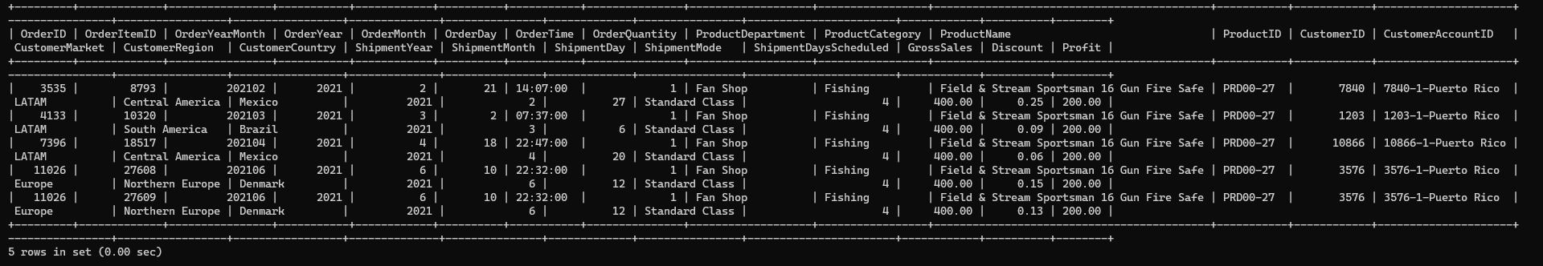

Slide 10
Normalised data
CREATE TABLE OrdersShipments (
OrderID INT,
OrderItemID INT PRIMARY KEY ,
OrderDay INT,
OrderMonth INT,
OrderYear INT,
OrderTime TIME,
OrderQuantity INT,
ProductID VARCHAR(255),
CustomerAccountID VARCHAR(255),
ShipmentYear INT,
ShipmentMonth INT,
ShipmentDay INT,
ShipmentMode VARCHAR(255),
ShipmentDaysScheduled INT,
GrossSales DECIMAL(10,2),
Discount DECIMAL(5,2),
Profit DECIMAL(10,2),
FOREIGN KEY (ProductID) REFERENCES Products(ProductID),
FOREIGN KEY (CustomerAccountID) REFERENCES Customers(CustomerAccountID)
);
CREATE TABLE Customers (
CustomerAccountID VARCHAR(255) PRIMARY KEY,
CustomerID VARCHAR(50),
CustomerMarket VARCHAR(255),
CustomerRegion VARCHAR(255),
CustomerCountry VARCHAR(255),
);
CREATE TABLE Products (
ProductID VARCHAR(255) PRIMARY KEY,
ProductDepartment VARCHAR(255),
ProductCategory VARCHAR(255),
ProductName VARCHAR(255)
);

Slide 11
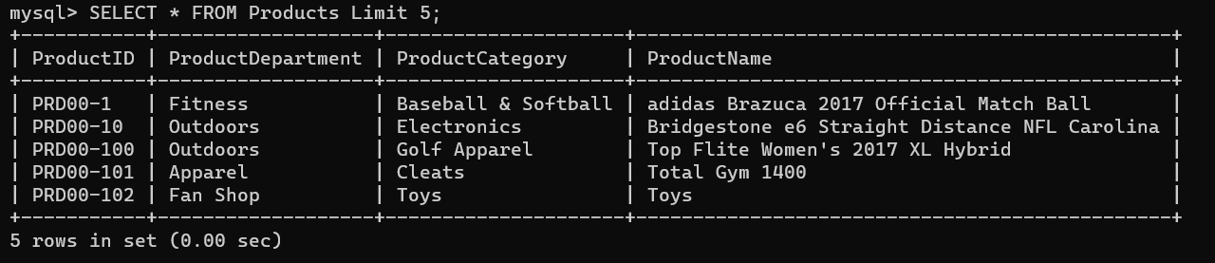
INSERT INTO Products (ProductID, ProductDepartment, ProductCategory, ProductName)
SELECT ProductID, ProductDepartment, ProductCategory, ProductName
FROM OrdersandShipments;
SELECT * FROM products LIMIT 5;

Slide 12
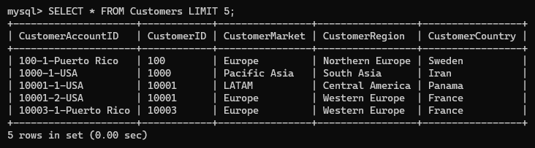
INSERT INTO Customers (CustomerAccountID, CustomerID, CustomerMarket, CustomerRegion, CustomerCountry)
SELECT CustomerAccountID, CustomerID, CustomerMarket, CustomerRegion, CustomerCountry
FROM OrdersandShipments;
SELECT * FROM customers LIMIT 5;

Slide 13
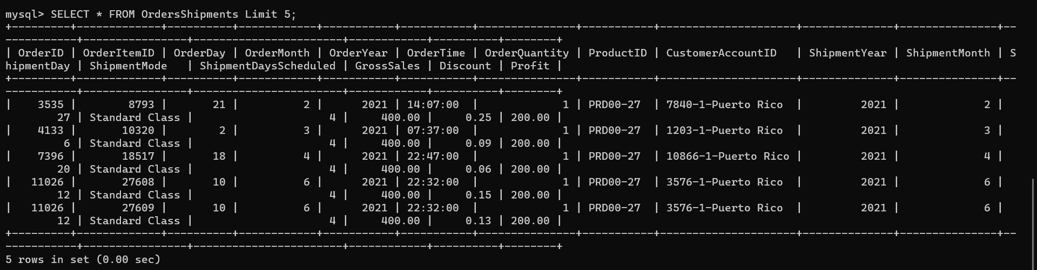
INSERT INTO OrdersShipments (OrderID, OrderItemID, OrderDay, OrderMonth, OrderYear, OrderTime, OrderQuantity, ProductID, CustomerAccountID, ShipmentYear, ShipmentMonth, ShipmentDay, ShipmentMode, ShipmentDaysScheduled, GrossSales, Discount, Profit)
SELECT
OrderID, OrderItemID, OrderDay, OrderMonth, OrderYear, OrderTime, OrderQuantity, ProductID, CustomerAccountID, ShipmentYear, ShipmentMonth, ShipmentDay, ShipmentMode, ShipmentDaysScheduled, GrossSales, Discount, Profit
FROM OrdersandShipments;
SELECT * FROM OrdersShipments LIMIT 5;

Slide 14
02
INTEGRATION OF MYSQL WITH SPARK USING JDBC CONNECTOR

Slide 15
After establishing necessary dependencies
val jdbcDF = spark.read
.format("jdbc")
.option("url", "jdbc:mysql://your_mysql_host:your_mysql_port/your_database_name")
.option("dbtable", "your_table_name")
.option("user", "your_username")
.option("password", "your_password")
.load()
resultDF.write
.format("jdbc")
.option("url", "jdbc:mysql://your_mysql_host:your_mysql_port/your_database_name")
.option("dbtable", "new_table_name")
.option("user", "your_username")
.option("password", "your_password")
.save()

Slide 16
03
DATA PROCESSING AND ANALYSIS IN SPARK

Slide 17
LOAD DATA IN SPARK USING JDBC
val Products = spark.read.format("jdbc").option("url", "jdbc:mysql://localhost/PROJECTF").option("driver", "com.mysql.cj.jdbc.Driver").option("dbtable", "Products").option("user", "root") .option("password", "yourpassword").load()
val Customers = spark.read.format("jdbc").option("url", "jdbc:mysql://localhost/PROJECTF").option("driver", "com.mysql.cj.jdbc.Driver").option("dbtable", "Customers").option("user", "root") .option("password", "yourpassword").load()
val OrdersandShipments = spark.read.format("jdbc").option("url", "jdbc:mysql://localhost/PROJECTF").option("driver", "com.mysql.cj.jdbc.Driver").option("dbtable", "OrdersShipments").option("user", "root") .option("password", "yourpassword").load()

Slide 18
Adding OrderDate and ShipmentDate in a separate column
val ordersWithDate = OrdersandShipments.withColumn("OD", date_format(concat_ws("-", col("OrderYear"), col("OrderMonth"), col("OrderDay")), "yyyy/MM/dd"))
val shipmentsWithDate = ordersWithDate.withColumn("SD", date_format(concat_ws("-", col("ShipmentYear"), col("ShipmentMonth"), col("ShipmentDay")), "yyyy/MM/dd"))
val OrdersShipments = shipmentsWithDate.withColumn("OrderDate", to_date(col("OD"), "yyyy/MM/dd")).withColumn("ShipmentDate", to_date(col("SD"), "yyyy/MM/dd"))
val OrderandShipment = OrdersShipments.drop("OrderYear", "OrderMonth", "OrderDay", "ShipmentYear", "ShipmentMonth", "ShipmentDay","OD", "SD")

Slide 19
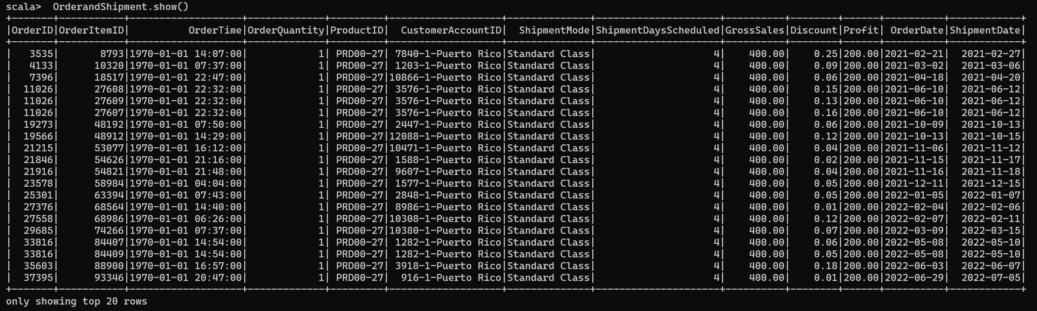

Slide 20
Store the data which is preprocessed back to mysql
val jdbcUrl = "jdbc:mysql://localhost/PROJECTF"
val connectionProperties = new java.util.Properties()
connectionProperties.put("user", "root")
connectionProperties.put("password", "Akshayaa_19")
connectionProperties.put("driver", "com.mysql.cj.jdbc.Driver")
OrderandShipment.write.mode("overwrite").jdbc(jdbcUrl, "processedfinal", connectionProperties)

Slide 21
Analysis

Slide 22
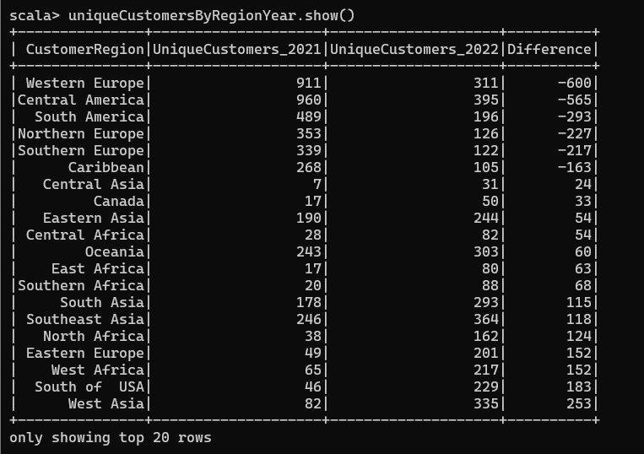
Analysis-1
Customer churn identification
val joinedData = OrderandShipment.join(Customers, Seq("CustomerAccountID"))
val uniqueCustomersByRegionYear = joinedData.groupBy("CustomerRegion").agg(
countDistinct(when(year(col("OrderDate")) === 2021, col("CustomerID"))).alias("UniqueCustomers_2021"),
countDistinct(when(year(col("OrderDate")) === 2022, col("CustomerID"))).alias("UniqueCustomers_2022")
).withColumn("Difference", col("UniqueCustomers_2022") - col("UniqueCustomers_2021")).orderBy(("Difference"))

Slide 23
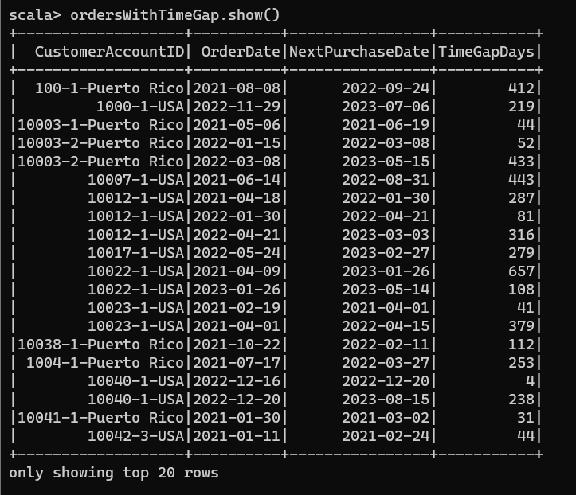
Analysis-2
import org.apache.spark.sql.expressions.Window
val joinedData = OrderandShipment.join(Customers, Seq("CustomerAccountID"))
val windowSpec = Window.partitionBy("CustomerAccountID").orderBy("OrderDate")
val ordersWithTimeGap = joinedData.withColumn("NextPurchaseDate", lead(col("OrderDate"), 1).over(windowSpec)).withColumn("TimeGapDays", datediff(col("NextPurchaseDate"), col("OrderDate"))).filter(col("TimeGapDays") =!= 0).select("CustomerAccountID", "OrderDate", "NextPurchaseDate", "TimeGapDays").orderBy("CustomerAccountID")

Slide 24
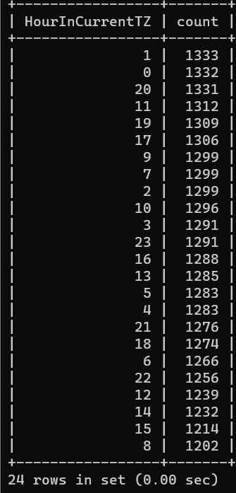
Analysis-3
val ordersWithHourInTimeZone = OrderandShipment.withColumn("HourInCurrentTZ", hour(col("OrderTime")))
val peakHours = ordersWithHourInTimeZone.groupBy("HourInCurrentTZ").agg(count("OrderQuantity").alias("count")).orderBy(col("count").desc)

Slide 25
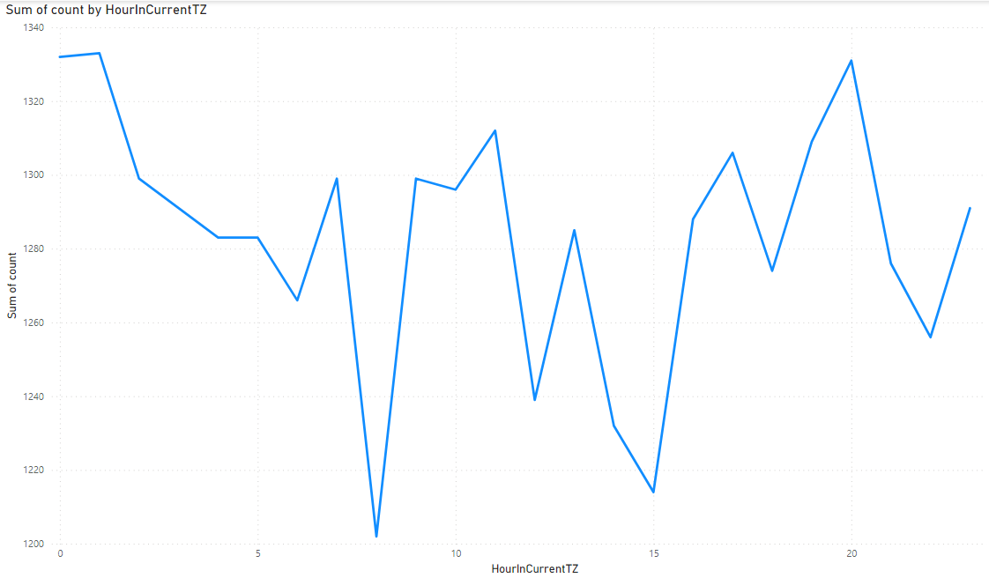

Slide 26
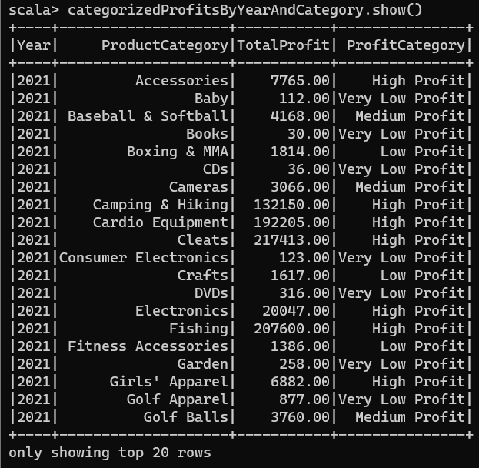
Analysis-4
val joinedData = OrderandShipment.join(Products, Seq("ProductID"))
val profitByYearAndCategory = joinedData .withColumn("Year", year(col("OrderDate"))) .groupBy("Year", "ProductCategory") .agg(sum("Profit").alias("TotalProfit")) .orderBy("Year", "ProductCategory")
val categorizedProfitsByYearAndCategory = profitByYearAndCategory .withColumn("ProfitCategory", when(col("TotalProfit") >= 5000, "High Profit") .when(col("TotalProfit") >= 2000 && col("TotalProfit") < 5000, "Medium Profit") .when(col("TotalProfit") >= 1000 && col("TotalProfit") < 2000, "Low Profit") .otherwise("Very Low Profit") )

Slide 27
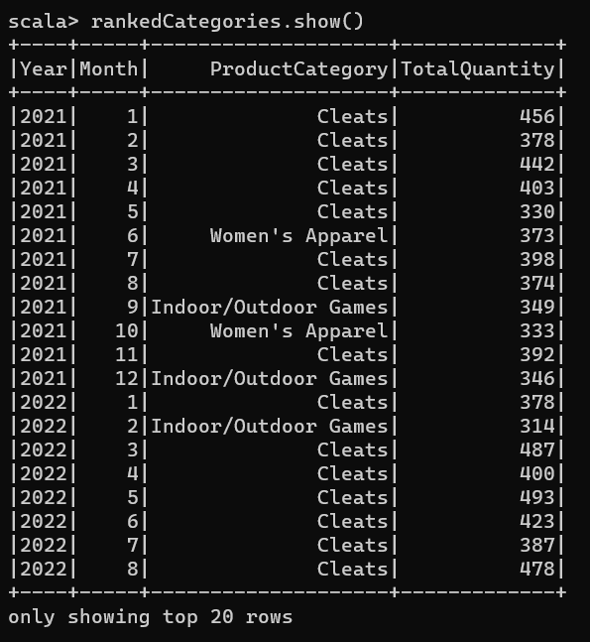
Analysis-5
import org.apache.spark.sql.expressions.Window
val joinedData = OrderandShipment.join(Products, Seq("ProductID"))
val highestCategoryByMonth = joinedData.withColumn("Year", year(col("OrderDate"))).withColumn("Month", month(col("OrderDate"))).groupBy("Year", "Month", "ProductCategory").agg(sum("OrderQuantity").alias("TotalQuantity"))
val windowSpec = Window.partitionBy("Year", "Month").orderBy(desc("TotalQuantity"))
val rankedCategories = highestCategoryByMonth.withColumn("rank", row_number().over(windowSpec)).where(col("rank") === 1).drop("rank")

Slide 28
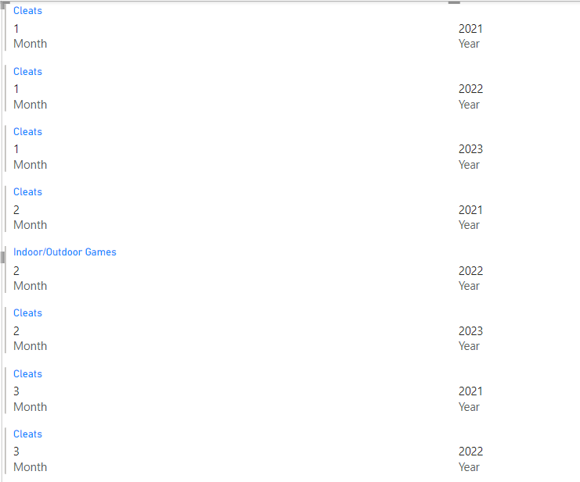

Slide 29
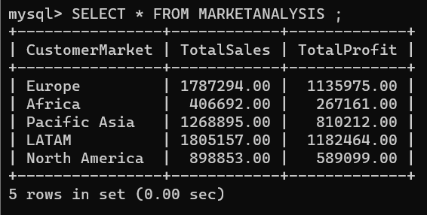
Analysis-6
val joinedData = OrderandShipment.join(Customers, Seq("CustomerAccountID"))
val marketAnalysis = joinedData.groupBy("CustomerMarket").agg(sum("GrossSales").alias("TotalSales"),sum("Profit").alias("TotalProfit"))
marketAnalysis.write.mode("overwrite").jdbc(jdbcUrl, "marketAnalysis", connectionProperties)

Slide 30
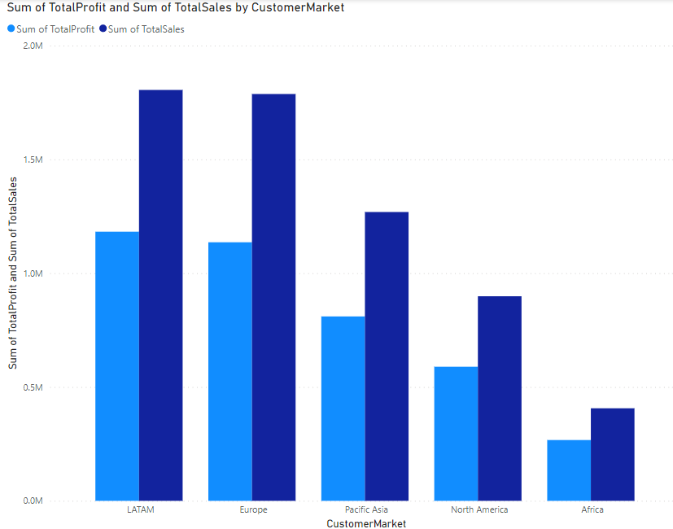

Slide 31
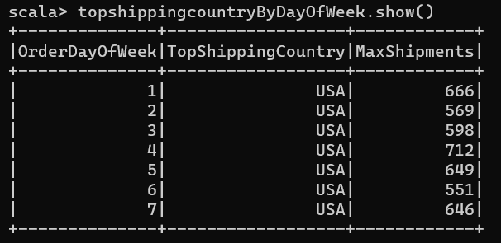
Analysis-7
val joinedData = OrderandShipment.join(Customers, Seq("CustomerAccountID"))
val ordersWithDayOfWeek = joinedData.withColumn("OrderDayOfWeek", dayofweek(col("OrderDate")))
val Popwarehouse = ordersWithDayOfWeek.groupBy("OrderDayOfWeek", "CustomerCountry").agg(count("OrderID").alias("ShipmentCount")).orderBy(col("OrderDayOfWeek"), col("ShipmentCount").desc)
val topshippingcountryByDayOfWeek = Popwarehouse.groupBy("OrderDayOfWeek").agg(
first("CustomerCountry").alias(TopShippingCountry"),
max("ShipmentCount").alias("MaxShipments")
).orderBy("OrderDayOfWeek")

Slide 32
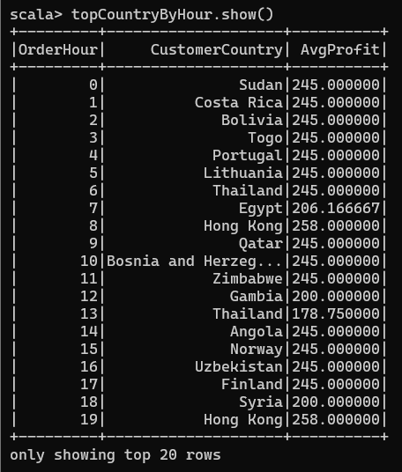
Analysis-8
val ordersWithHourAndCountry = joinedData.withColumn("OrderHour", hour(col("OrderTime")))
val avgProfitByHour = ordersWithHourAndCountry.groupBy("OrderHour", "CustomerCountry").agg(avg("Profit").alias("AvgProfit"))
val windowSpec = Window.partitionBy("OrderHour").orderBy(desc("AvgProfit"))
val topCountryByHour = avgProfitByHour.withColumn("rank", row_number().over(windowSpec)).filter(col("rank") === 1).drop("rank").orderBy("OrderHour")

Slide 33
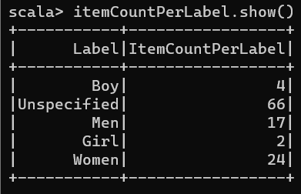
Analysis-9
import org.apache.spark.sql.functions._
val joinedData = OrderandShipment.join(Products, Seq("ProductID"))
val labeledProducts = joinedData.withColumn("Label",
when(col("ProductName").contains("Men"), "Men").when(col("ProductName").contains("Women"), "Women").when(col("ProductName").contains("Girl"), "Girl").when(col("ProductName").contains("Boy"), "Boy").otherwise("Unspecified")
)
val itemCountPerLabel = labeledProducts.groupBy("Label").agg(count("*").alias("ItemCountPerLabel"))

Slide 34
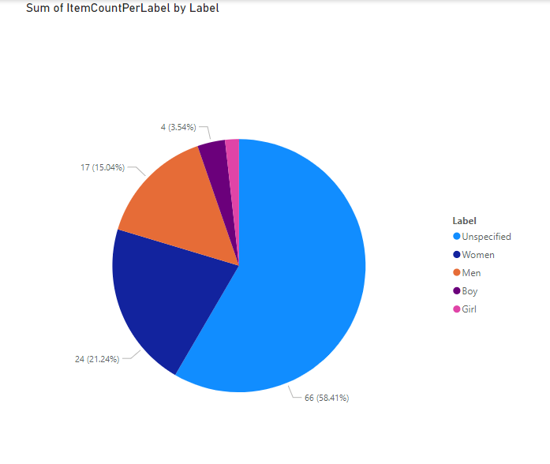

Slide 35
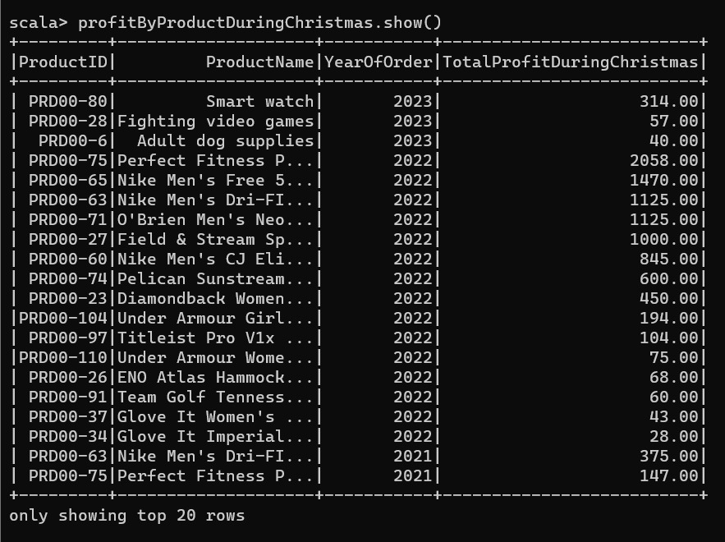
Analysis-10
val joinedData = OrderandShipment.join(Products, Seq("ProductID"))
val christmasProfit = joinedData.withColumn("YearOfOrder", year(col("OrderDate"))).withColumn("DayOfYear", dayofyear(col("OrderDate"))).filter(col("DayOfYear") === 359)
val profitByProductDuringChristmas = christmasProfit.groupBy("ProductID", "ProductName","YearOfOrder").agg(sum("Profit").alias("TotalProfitDuringChristmas")).orderBy(desc("YearofOrder"),desc("TotalProfitDuringChristmas"))

Slide 36
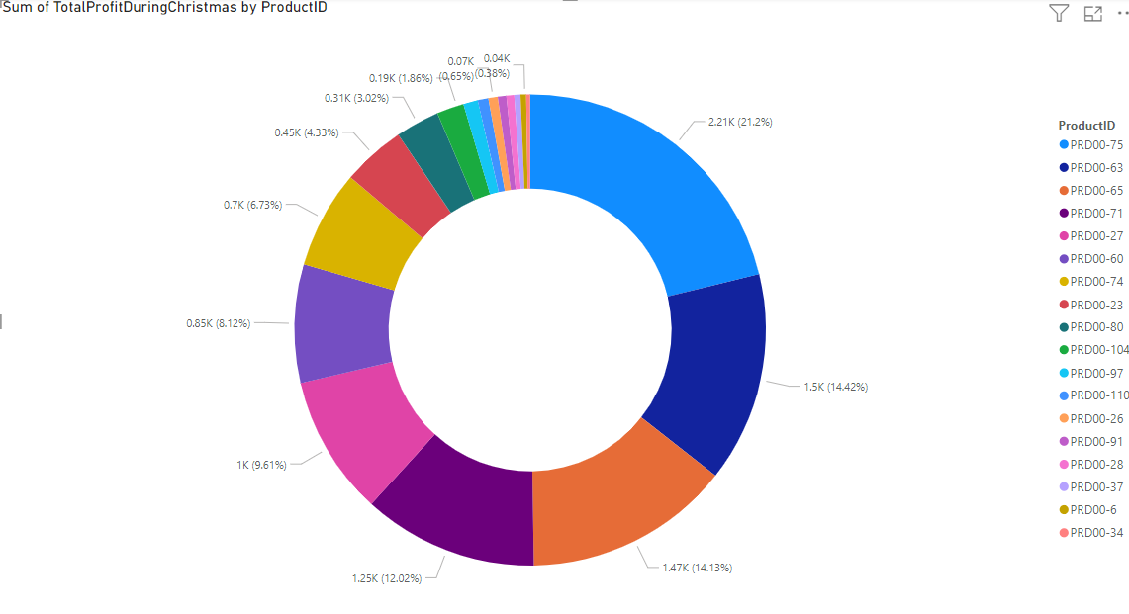

Slide 37
THANK YOU

